Slide 1
An empirically Calibrated Timegan framework
Milan, Italy
17/11/2025
Pablo Alfaro Lizano
Supervisor: Professor Rocco Mosconi
Polimi - Gsom
Business Analytics & Data Science
Stress testing financial portfolios with synthetic time series

Slide 2
Motivation & context
Data & Methodology
Results & Validation
Applications & Outlook
Q&A

Slide 3

Motivation: Financial Stress Testing
What is financial stress testing?
Unpredictibility
Correlated losses
Unprecedented volatility & liquidity stress
New explorations

Slide 4
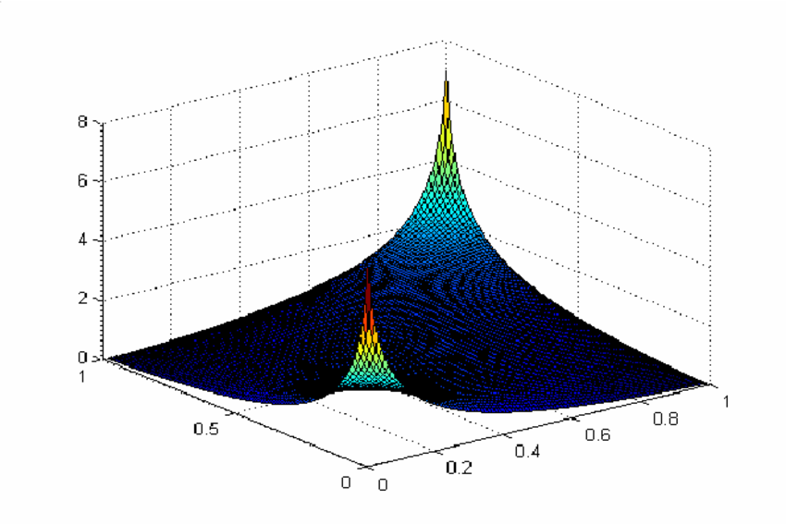
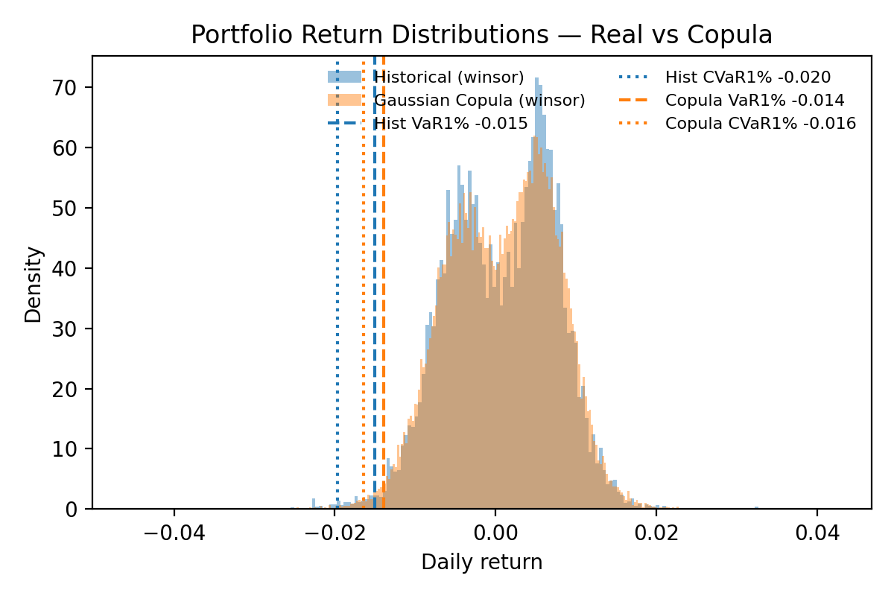
Traditional methods & Limitations
Historical Simulation
Today’s portfolios on past scenarios
Outcome limited
Gaussian Copulas
Join assets on correlation matrix
Dependance assumptions

Slide 5

New frontiers: Model overview
New models: DNN, RNN, LSTMs
Generative Adversarial Networks (GANs)
Learn to generate data
TimeGAN
Generative power
Temporal architecture

Slide 6
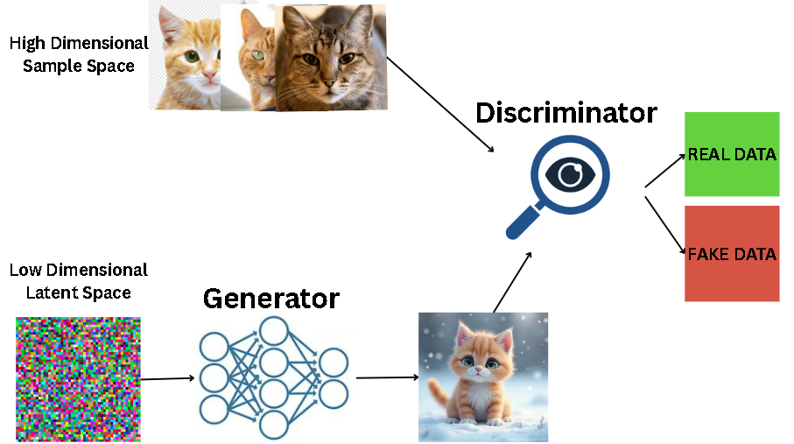
Model Overview: GAN

Slide 7
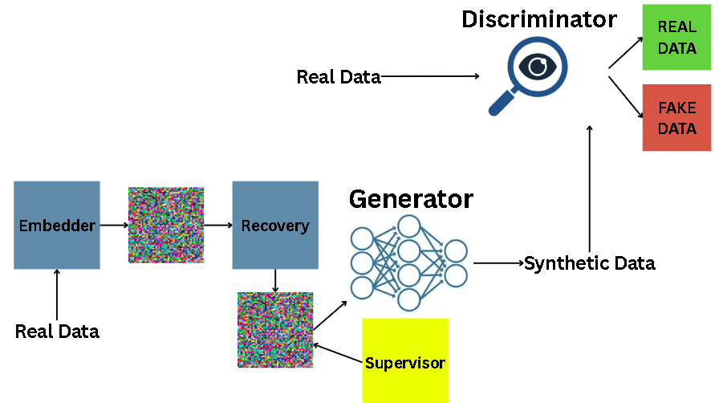
Model Overview: TimeGAN

Slide 8

Data Gathering & Preparation
Dataset
Equity, fixed income, credit market proxies
Risk factors
26 features (2004 – 2025)
TimeGAN compatability
60 day rolling windows
Regime labels
4,400 / 60 / 26
Missingness
Exogenous factors
Asset-level prices

Slide 9

Model Development & Calibration
Calibrated in valuation metrics
Discriminative Score
Predictive Score
Kolmogorov-Smirnov (KS) Distance
Relative weights of loss terms
Reconstruction term
Supervised term
Adverserial term
Training setup
Generator : Discriminator = 2 : 1
Batch size = 128
Learning Rate = 1e–4
Optimizer β₁, β₂ = 0.9, 0.999
$$\text{Ltotal}\text{​=}\text{λ}\text{rec}\text{​}\text{Lrec}\text{​+}\text{λ}\text{sup}\text{​}\text{Lsup}\text{​+}\text{λ}\text{adv}\text{​}\text{Ladv}\text{​+}\text{λ}\text{gp}\text{​}\text{Lgp}\text{​}$$

Slide 10
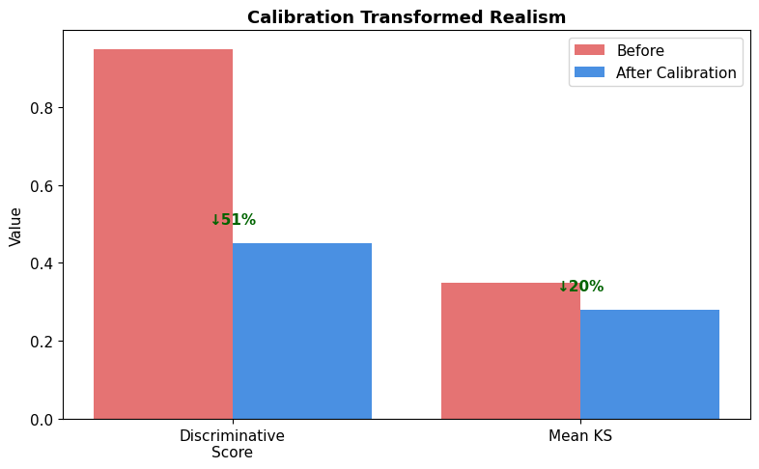
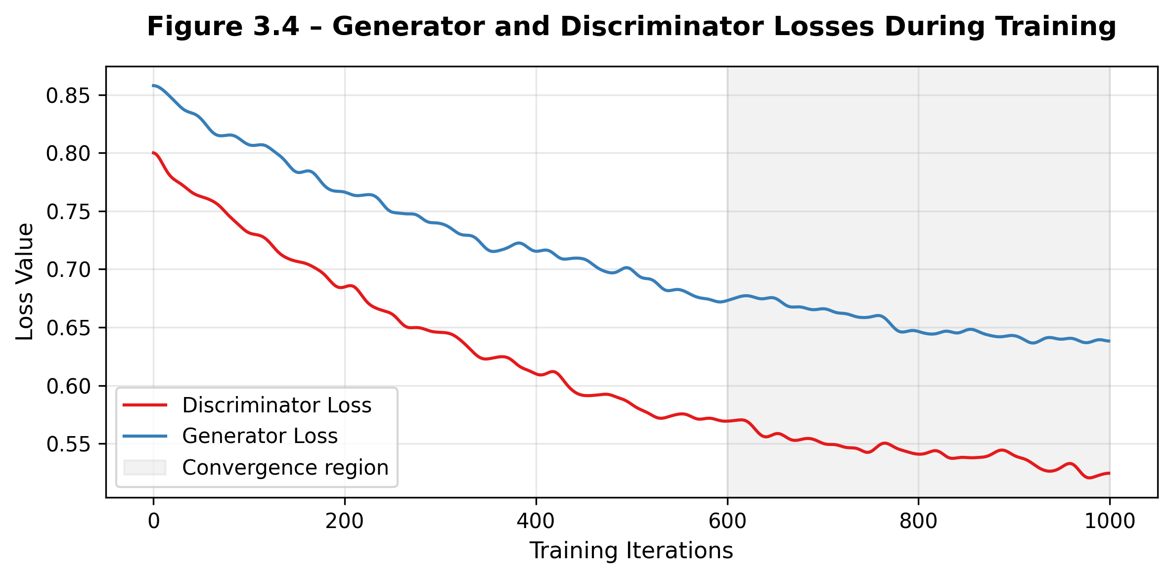
Results & Diagnostics
Discriminative Score = 0.45
Generator performance
Predictive Score (MSE) = 0.017
Short-term temporal dependancies
Kolmogorov-Smirnov (KS) statistic = 0.22
Ditributional distance of features
Consistancy reached

Slide 11
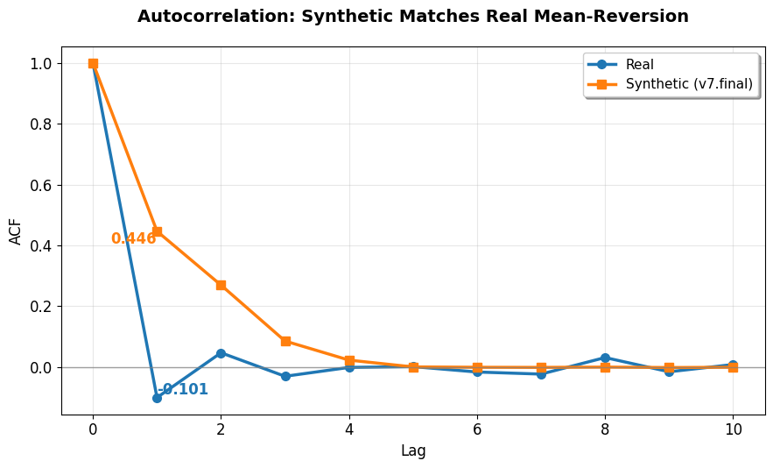
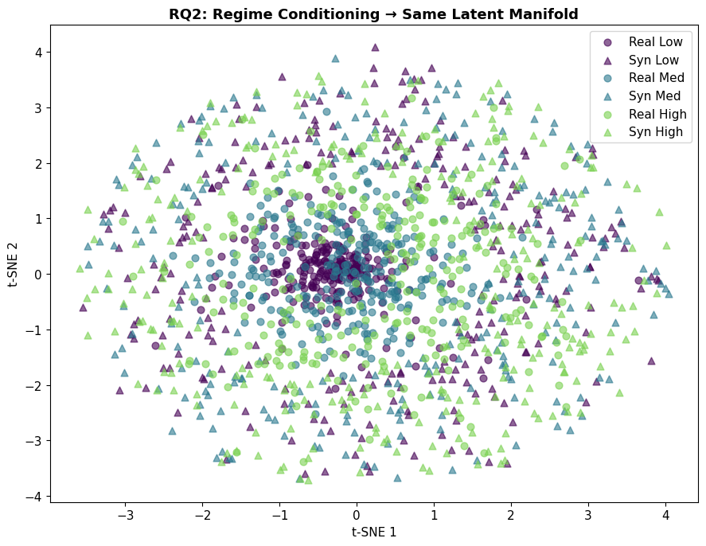
Results & Diagnostics

Slide 12
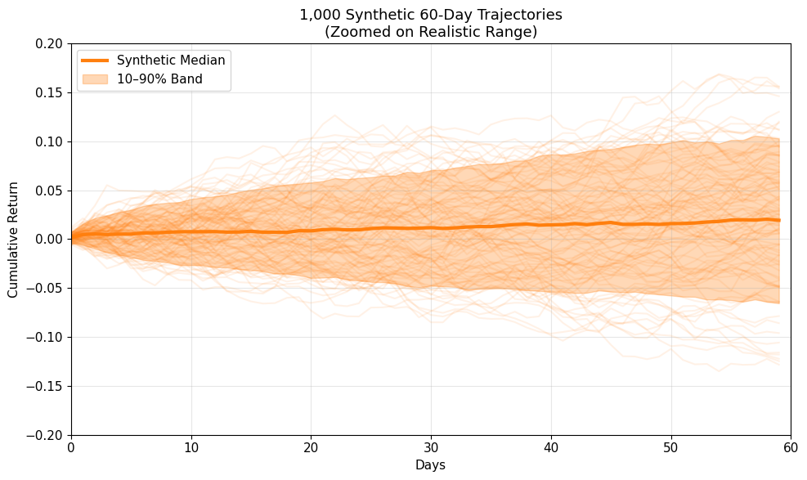
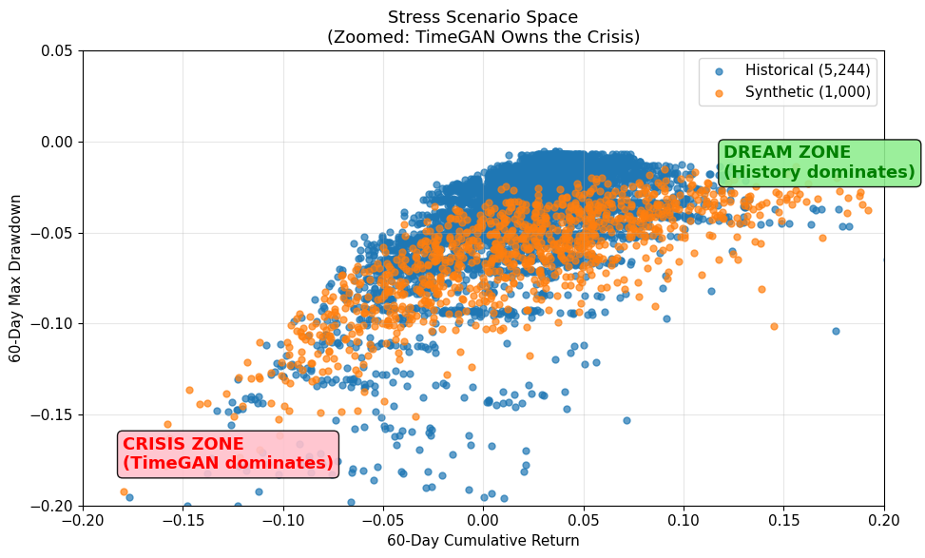
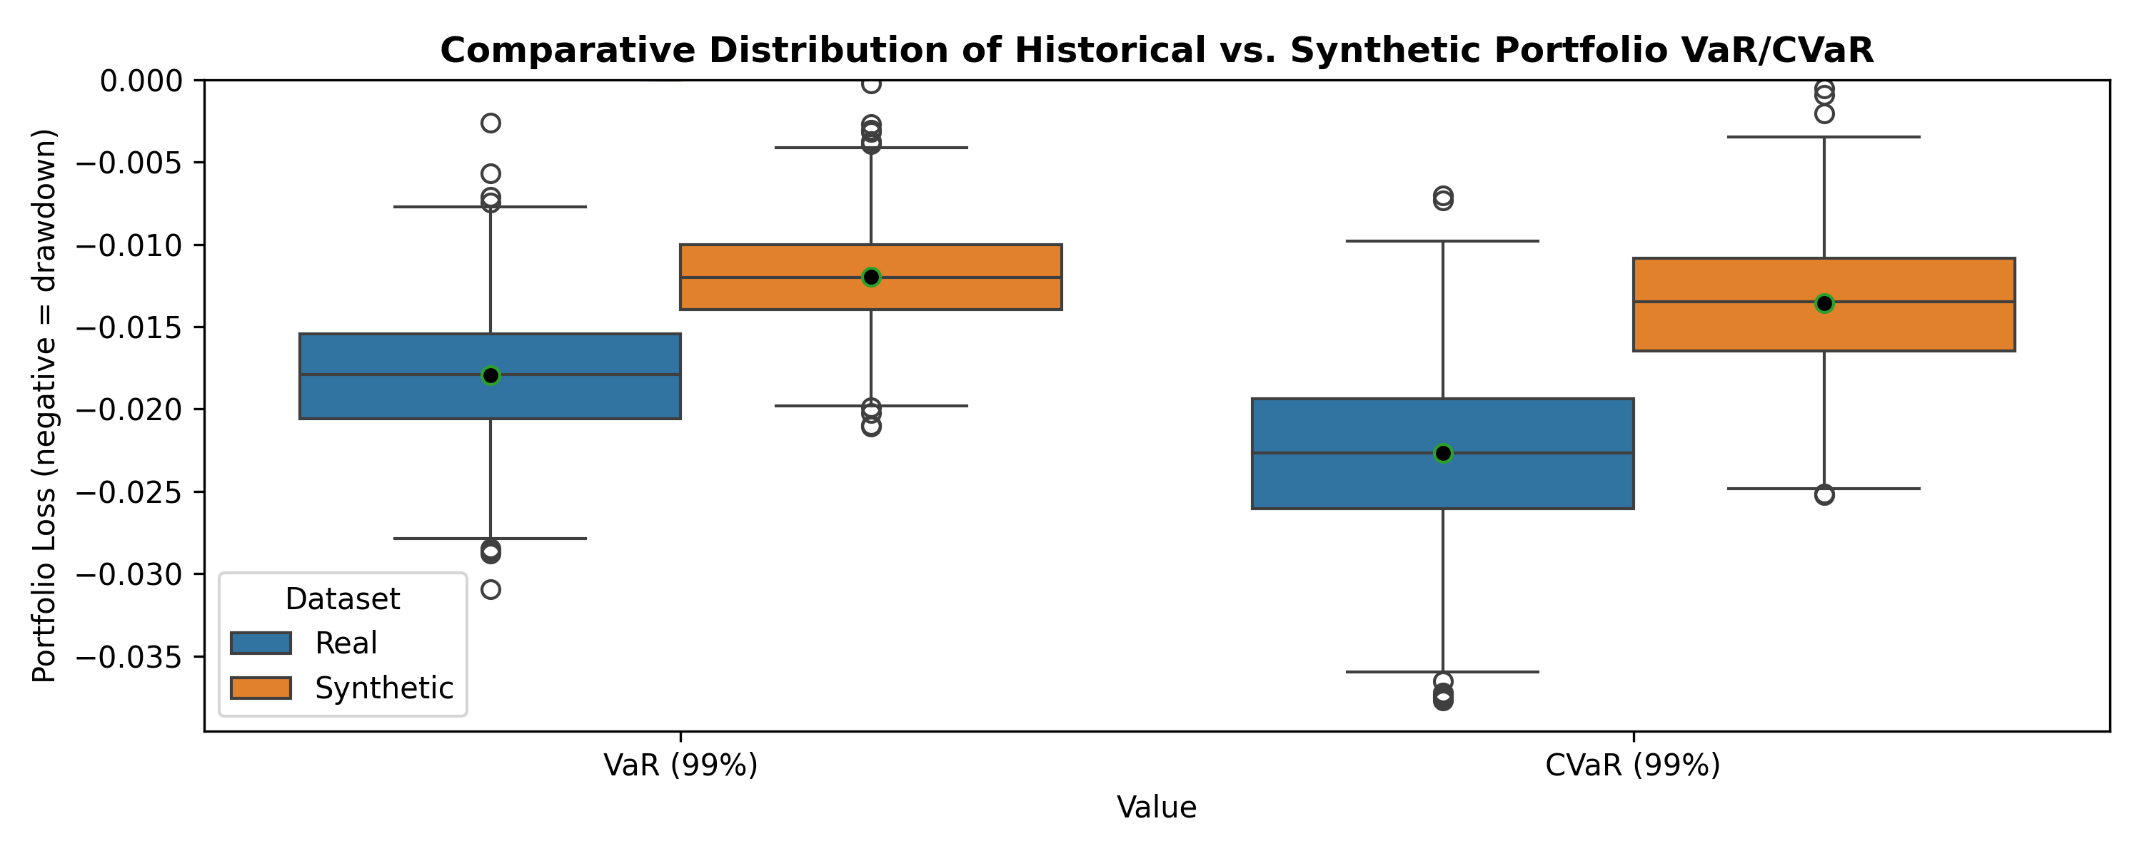
Practical Applications
Real Value at Risk (VaR) 95% = -2.8%
Real Conditional Value at Risk (CVaR) beyond 95% =-3.9%
Synthetic Value at Risk (VaR) 95% = -2.7%
Synthetic Conditional Value at Risk (CVaR) beyond 95% = -3.8%
Equally Weighted Portfolio
Volatility Clustering
Correlated Drawdowns

Slide 13

Limitations & Future Work
Limited number of variables
Expansion of dataset
Economical interpretation
Translation into meaningful narratives
Multi asset / Sector-level
Broader pipeline

Slide 14
Thank you
Q&A
Pablo.alfaro@gsom.polimi.it

Slide 15
Extra Information
λ_adv = 5.0 (Adversarial loss weight)
λ_sup = 1.0 (Supervised loss weight for temporal coherence)
λ_rec = 0.5 (Reconstruction loss weight)
λ_gp = 1.0 (Gradient penalty for stability)
Solution to «under dispersion»
Calculated scale = std(real) / std(synthetic) and rescaled the synthetic outputs. This is a global, multiplicative correction that preserves the internal covariance structure.
Autocorrelation Lag-1 Gap (|ΔACF1|): ≈ 0.14 - Realistic temporal structure (volatility clustering).
A missing value In proxies is often a data feed error, not a market closure. A missing value here is often a data feed error, not a market closure.
The Supervisor can sometimes be too effective, penalizing large, abrupt jumps. This is a contributing factor to the slight tail compression we observe in CVaR₉₉. The model learns to be "too temporally consistent," smoothing over the most extreme, discontinuous market breaks. Future Mitigation: A stochastic or less weighted supervisor in high-volatility regimes could help preserve these "jumps."
The Latent Space Feature Influence Map (Fig. 8) isn't random. We observed clustering where, for instance, one region of the space was dominated by embeddings where VIX was the dominant feature (crisis states), while another was dominated by bond features (flight-to-safety states).
        The "So What?": This proves TimeGAN isn't just memorizing; it's building an internal, non-linear map of financial regimes. This structured latent space is what allows it to generate novel but plausible trajectories by interpolating between these learned states.

